Slide 1
Task | Command Name | Syntax | Example | Screenshots
To get manual page for the known command | man | man command | man ls
To get manual page for the unknown command | man -k [keyword] or apropos calender | man -k [keyword] or apropos calender | apropos calender
To know the source file binary | whereis | whereis [command] | whereis ls
To know the path of the command | which | which [command] | which mv
To know the command is external or internal | type | type command | type cd , type mv
To get help for the internal command | help | help [internal_command] | help cd
To list out bash commands | help | help | help
To know the usage of the command | man | man command | man ls

Slide 2
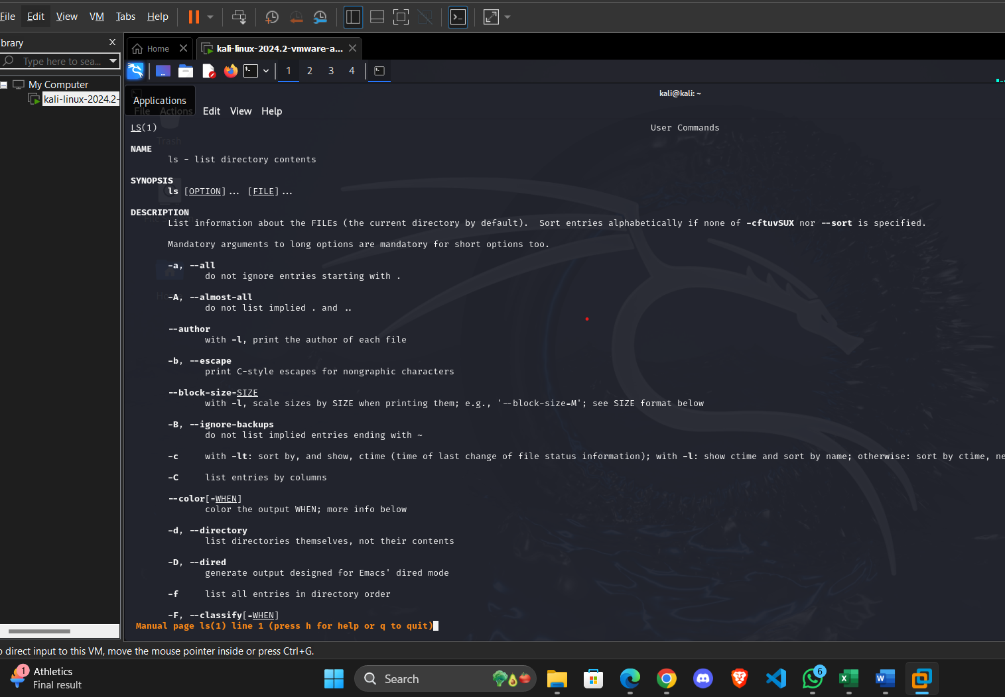
To get manual page for the known command

Slide 3
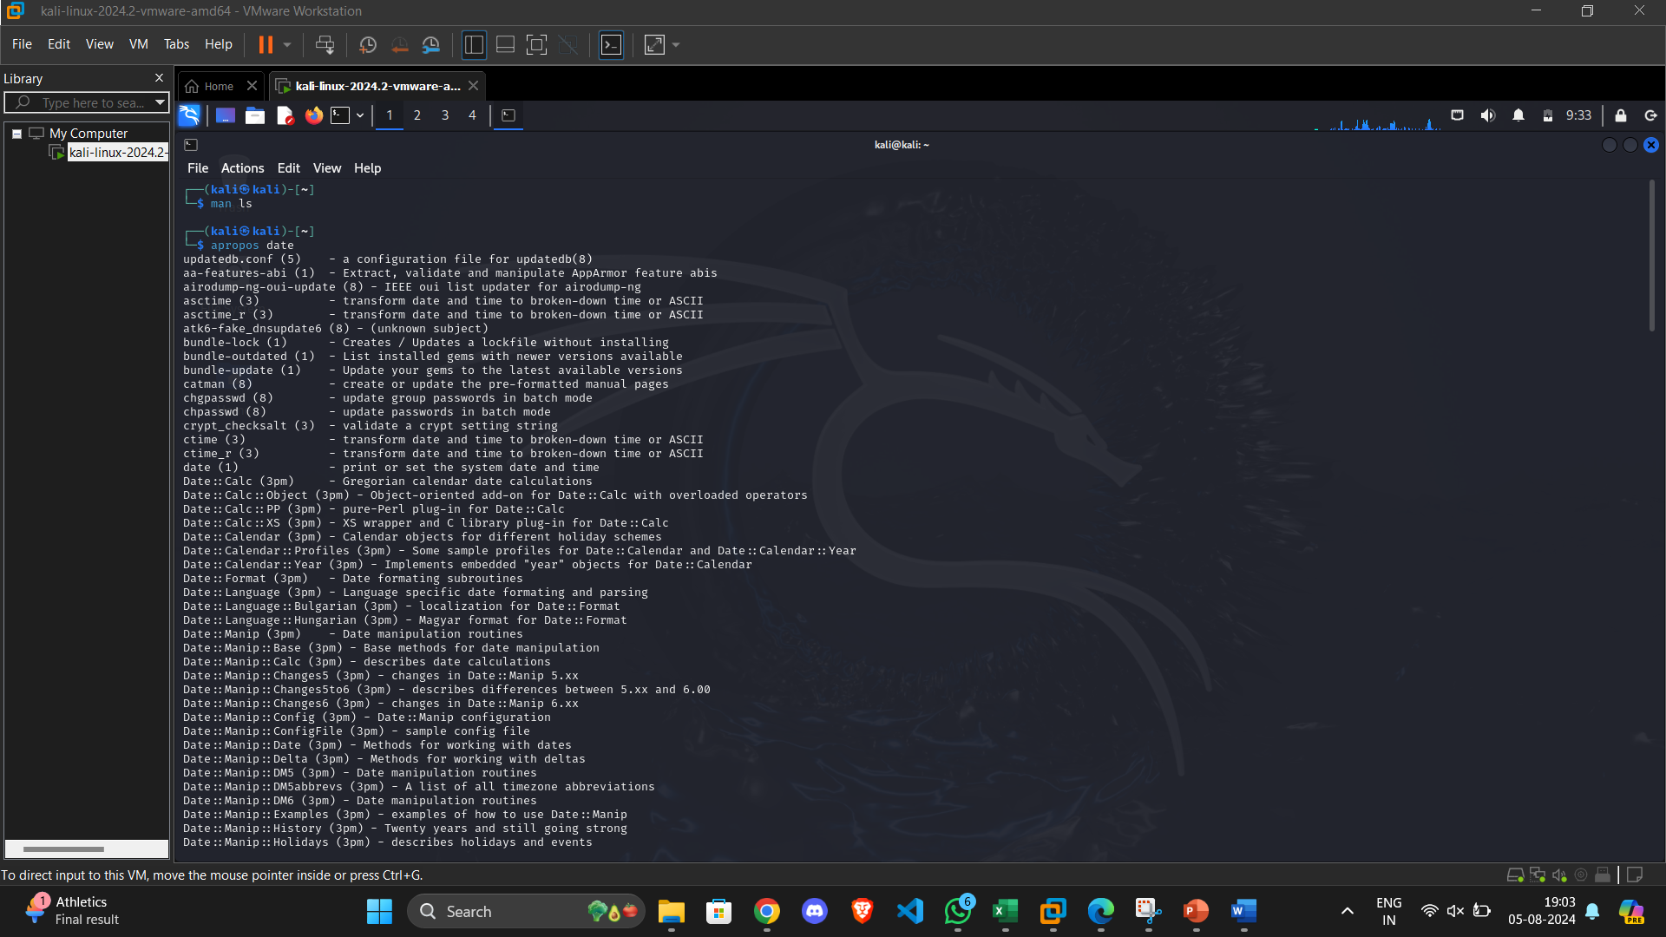
To get manual page for the unknown command

Slide 4
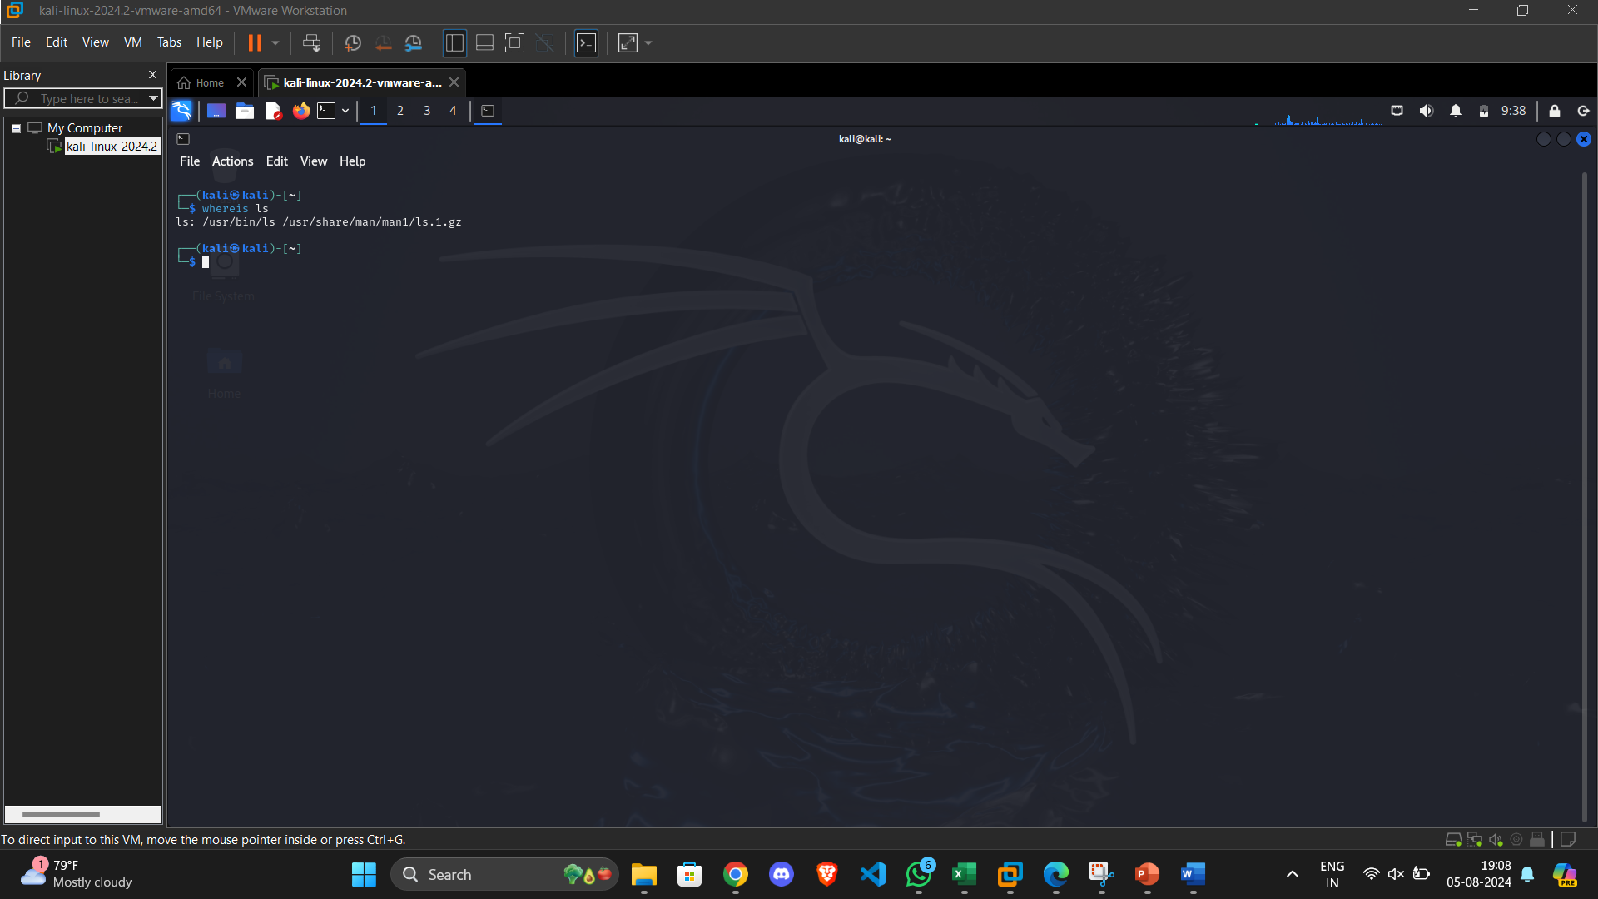
To know the source file binary

Slide 5
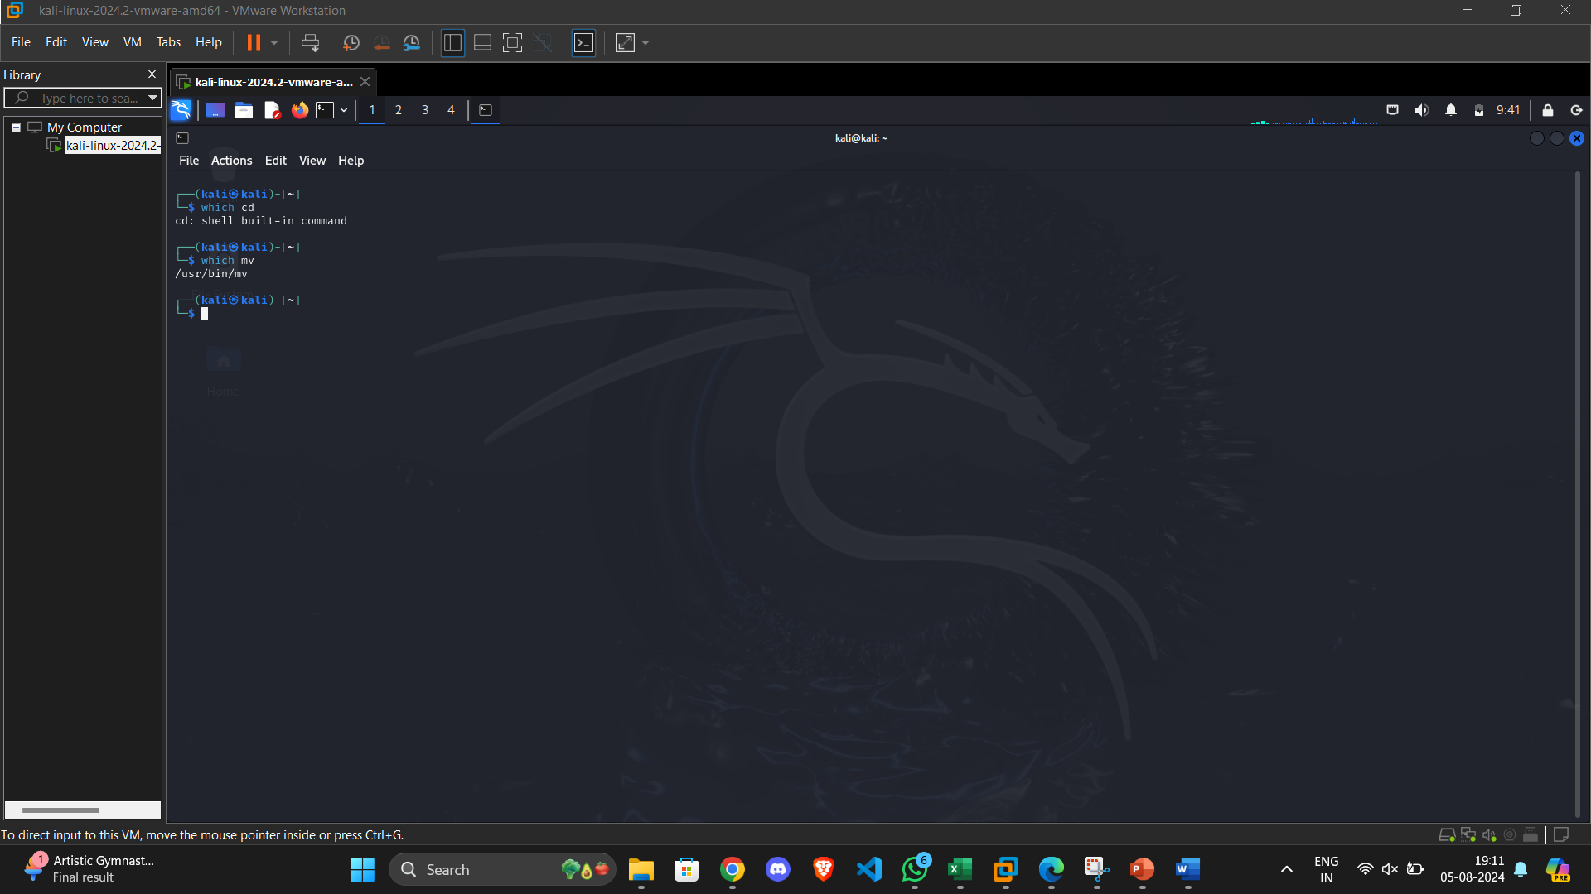
To know the path of the command

Slide 6
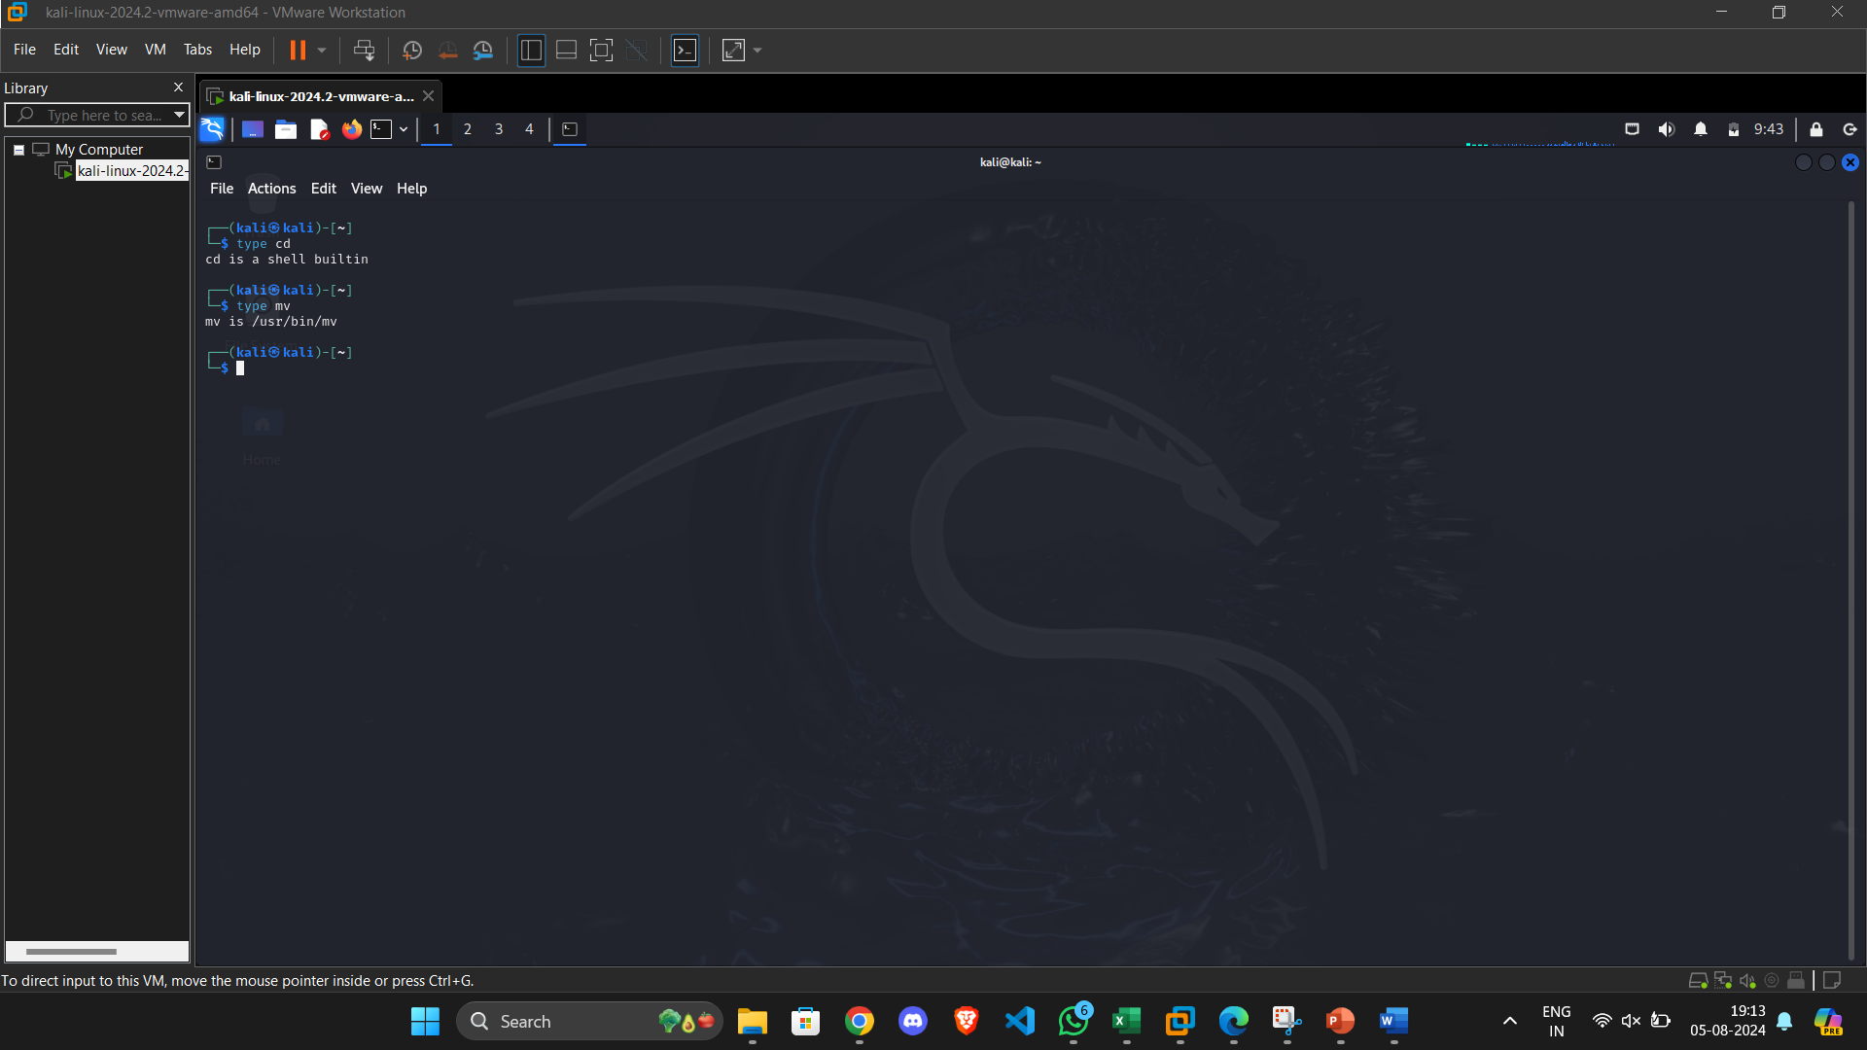
To know the command is external or internal

Slide 7
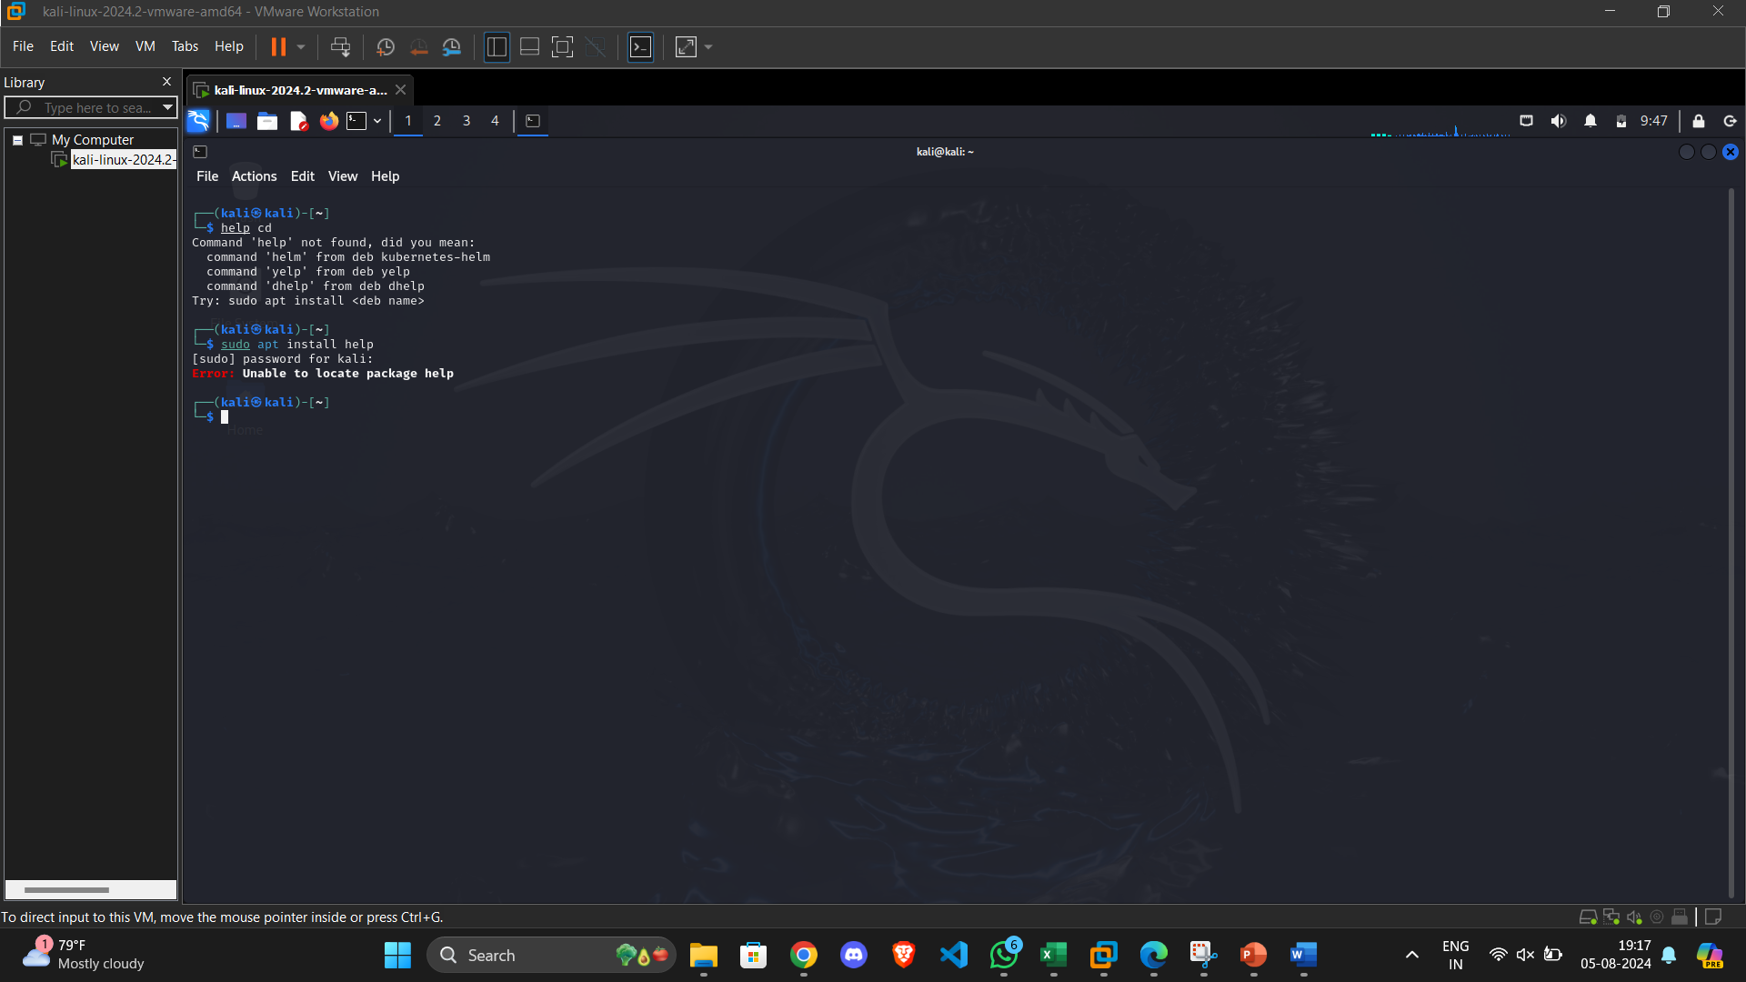
To get help for the internal command

Slide 8
Task | Command Name | Syntax | Example | Screenshots
To know today’s date | date | date | date
To print calendar | cal | cal | cal
To print default shell | echo | echo $SHELL | echo $SHELL
To print currently logged in user | who | who | who
To create shortcut for command | alias | alias shortcut-name=‘command’ | alias mm=‘man’
To delete shortcut | unalias | unalias shortcut_name | unalias mm
To change the timestamp of the file | touch | touch filename
To clear the screen | clear | clear | clear
To create empty files | touch | touch filename.txt | touch filename.txt
To know disk usage | df -h | df -h | df -h
To know free space in the system | df -h | df -h | df-h
To know about the Linux release | cat /etc/os-release or uname –r or hostnamectl | cat /etc/os-release or uname –r or hostnamectl | cat /etc/os-release or uname –r or hostnamectl

Slide 9
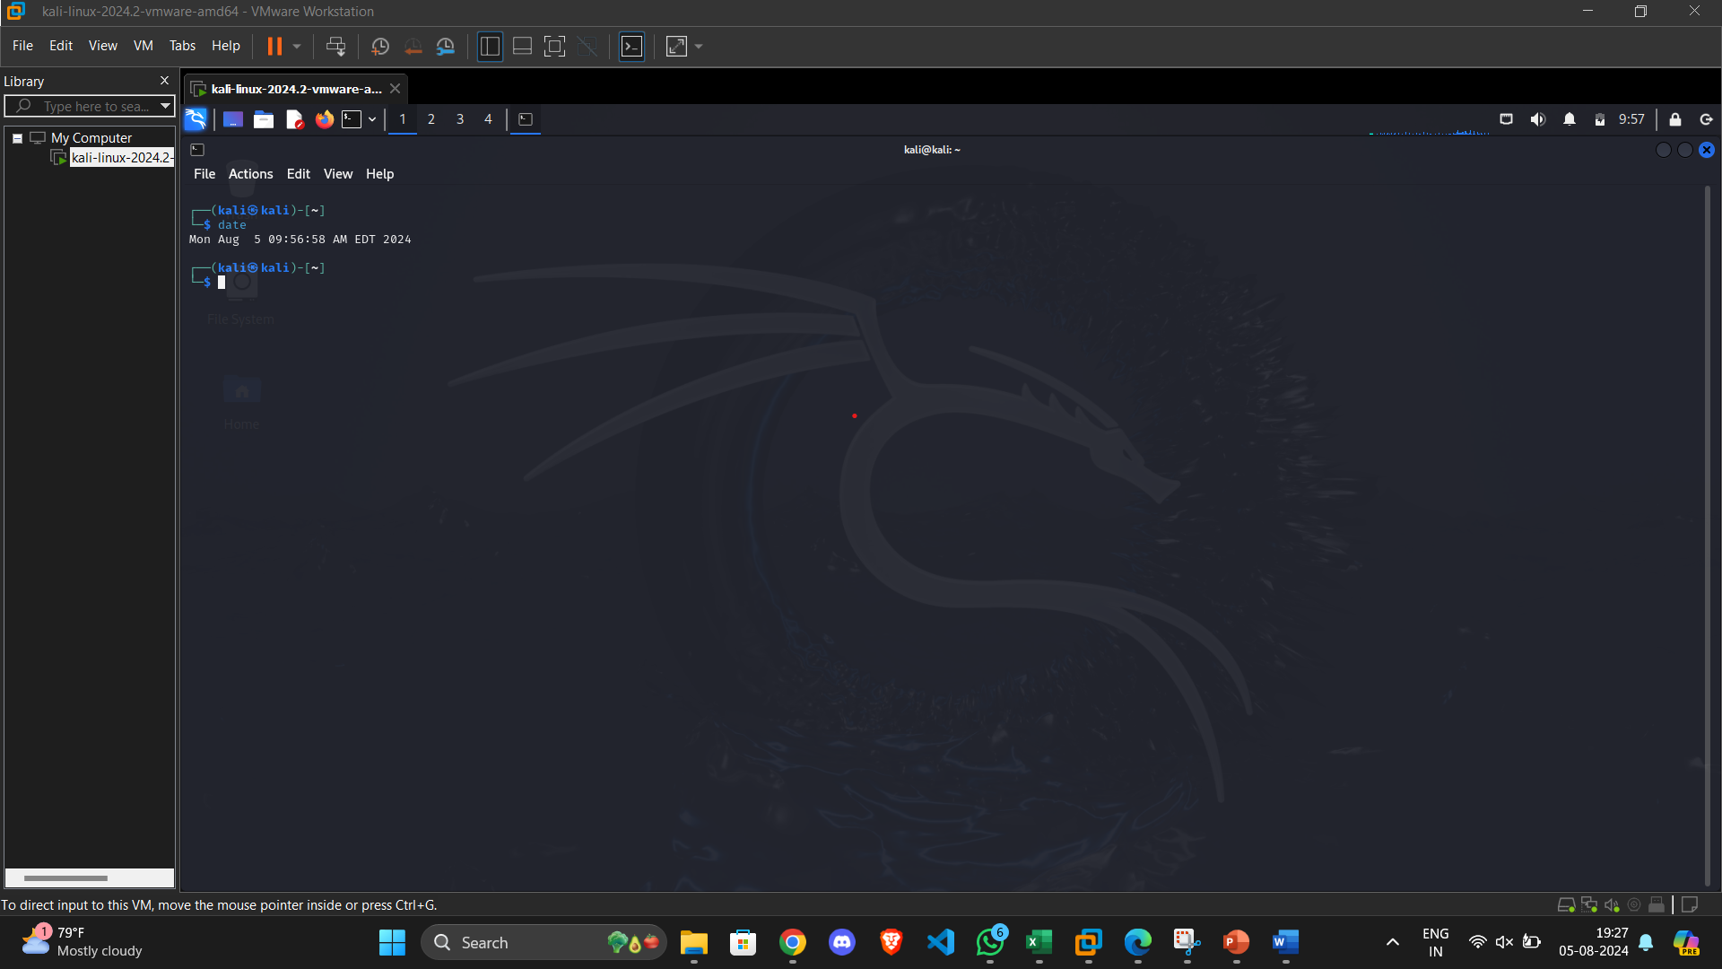
To know today’s date

Slide 10
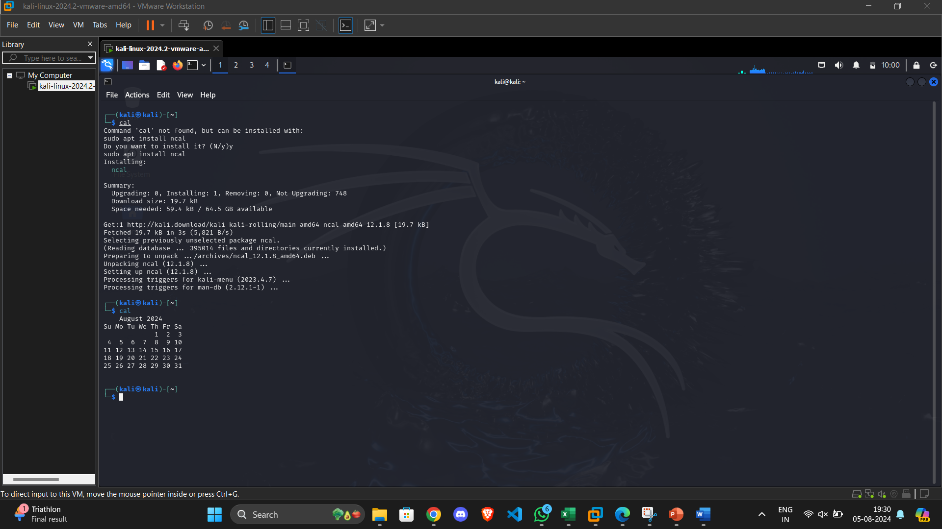
To print calendar

Slide 11
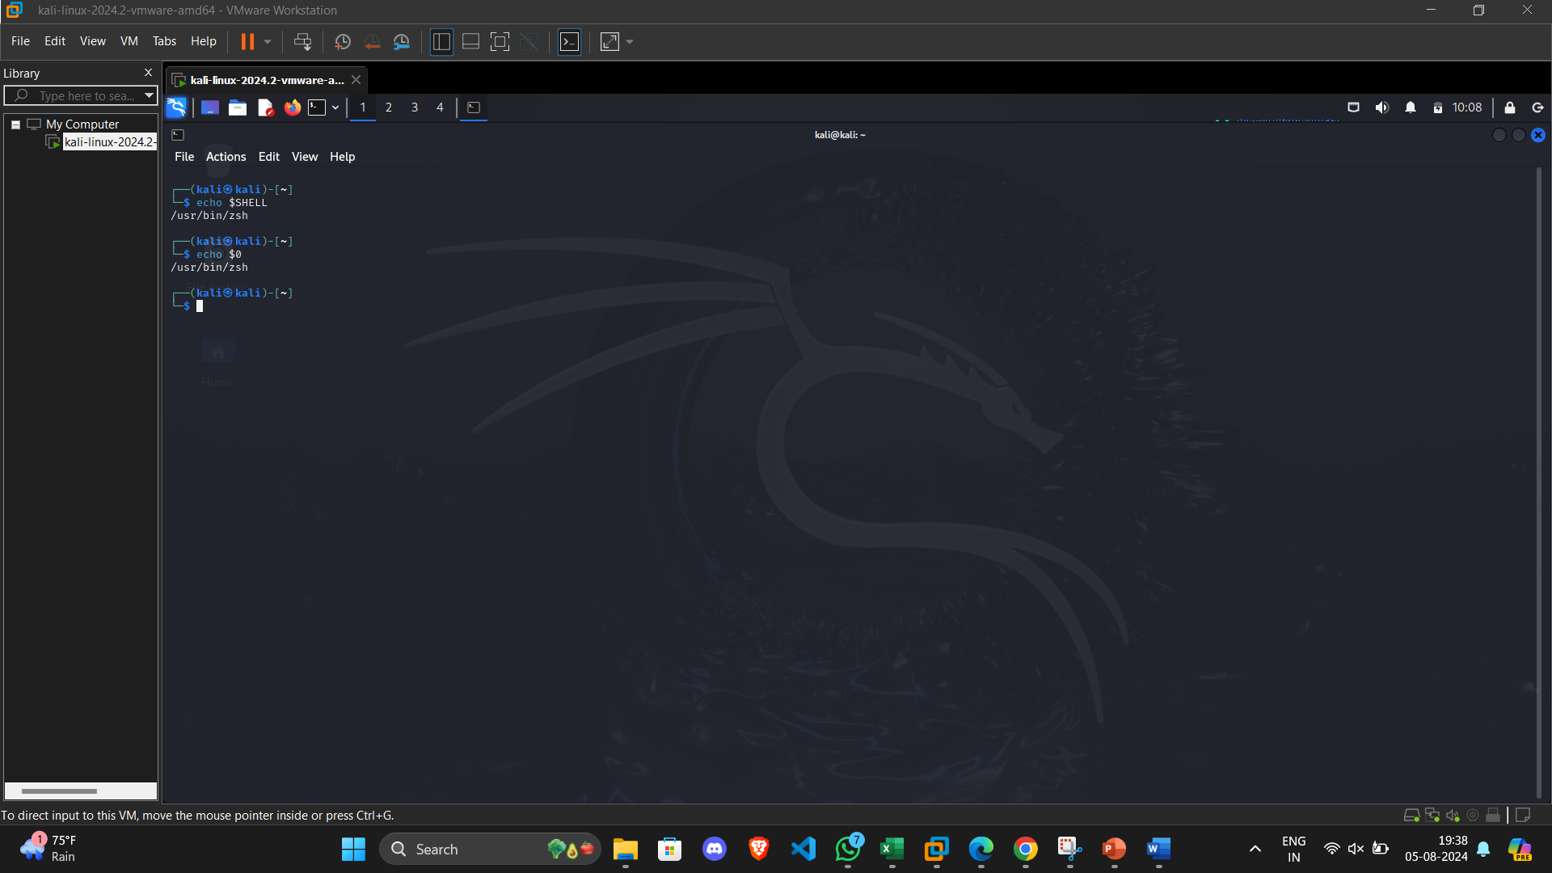
To print default shell

Slide 12
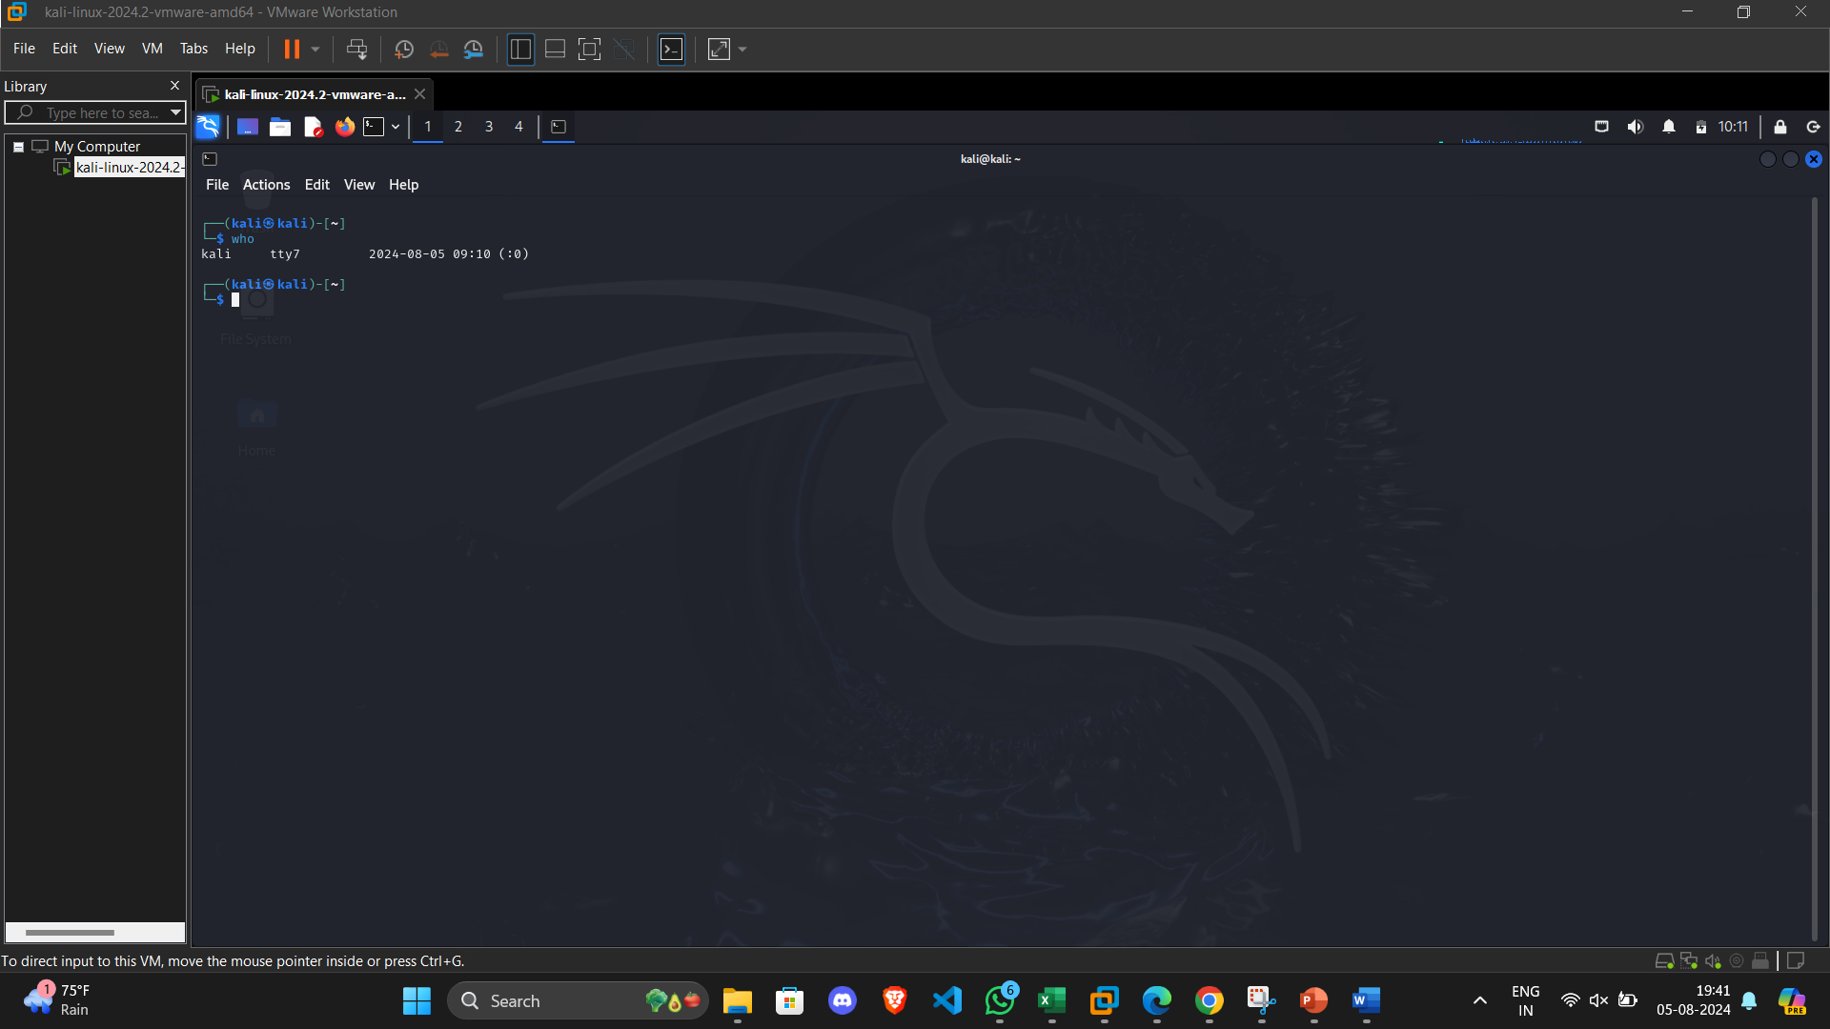
To print currently logged in user

Slide 13
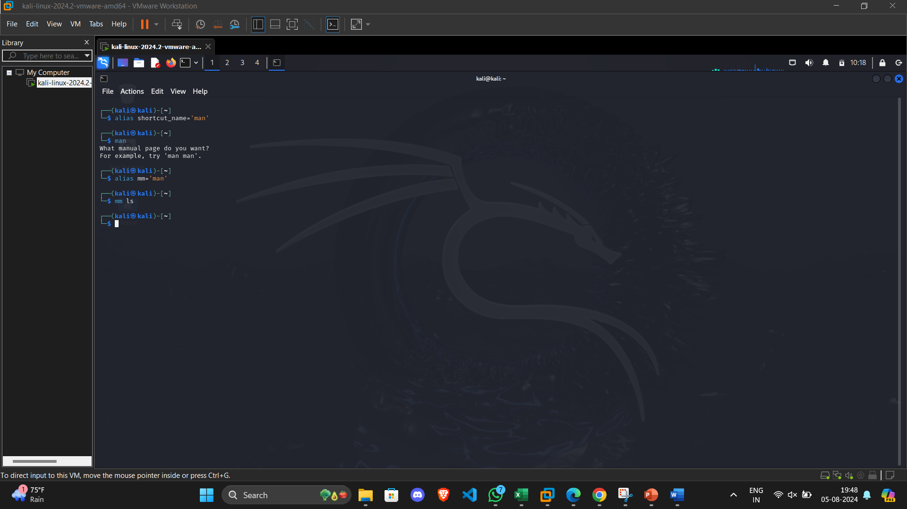
To create shortcut for command

Slide 14
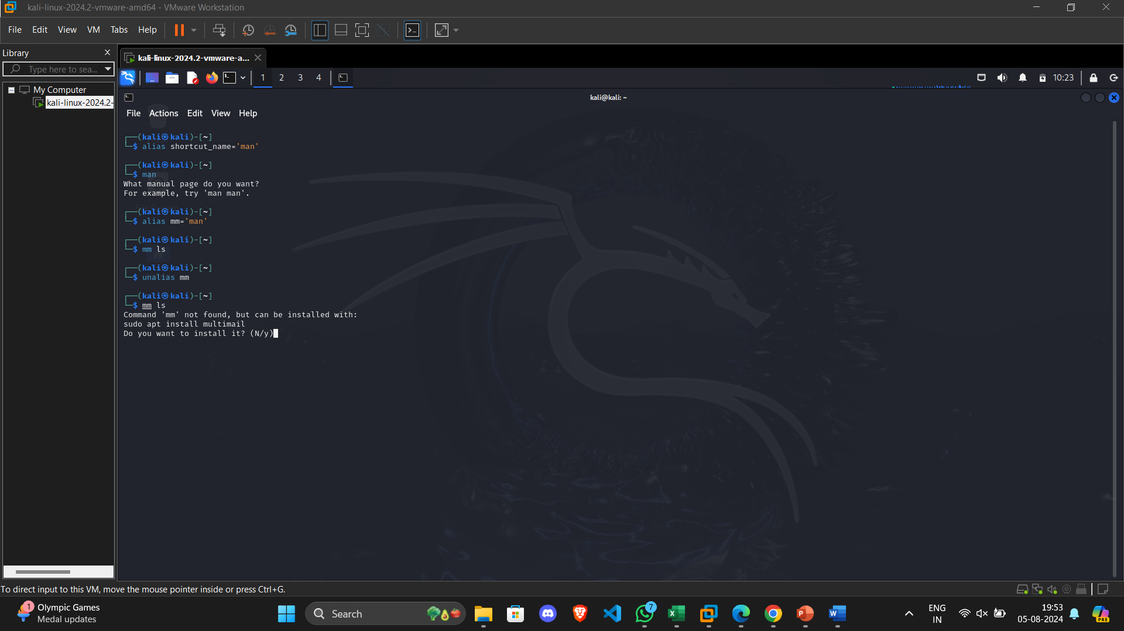
To delete shortcut

Slide 15
To change the timestamp of the file

Slide 16
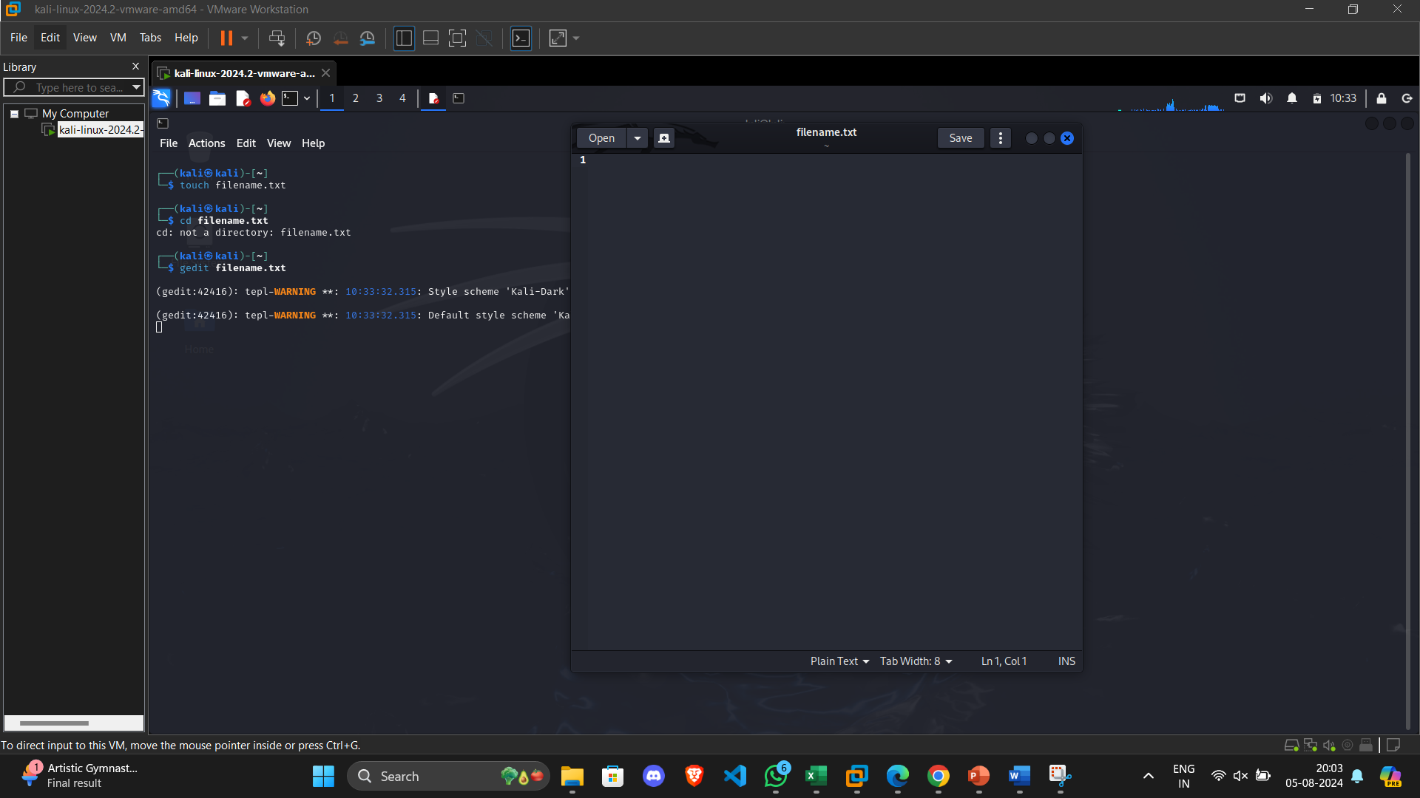
To create empty files

Slide 17
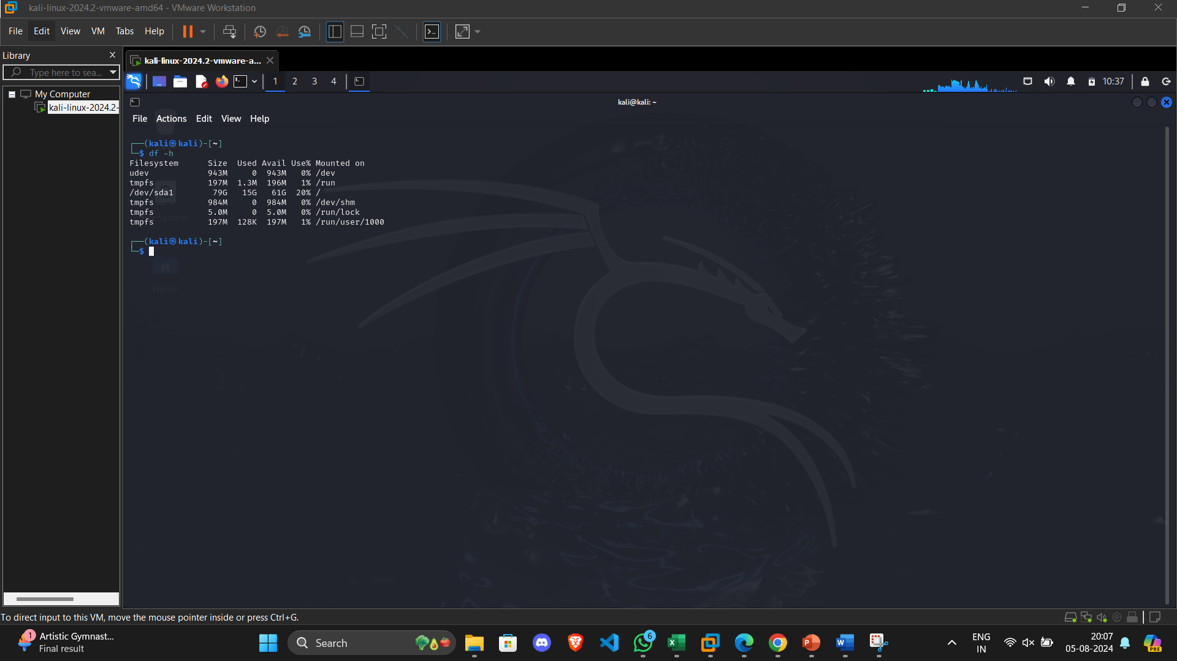
To know disk usage

Slide 18
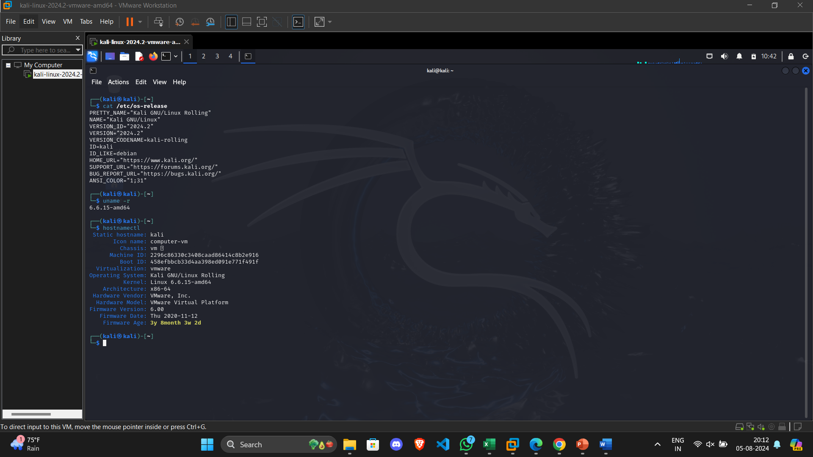
To know about the Linux release

Slide 19
Navigation
Navigation
Task | Command | Syntax | Screenshots
To navigate home directory | cd | cd
To navigate to the parent directory | cd | cd ..
To navigate to the child directory | cd | cd filename
Alternate command to cd
To go back to the previous directory | cd | cd ..
To go to the root directory | cd | cd /

Slide 20
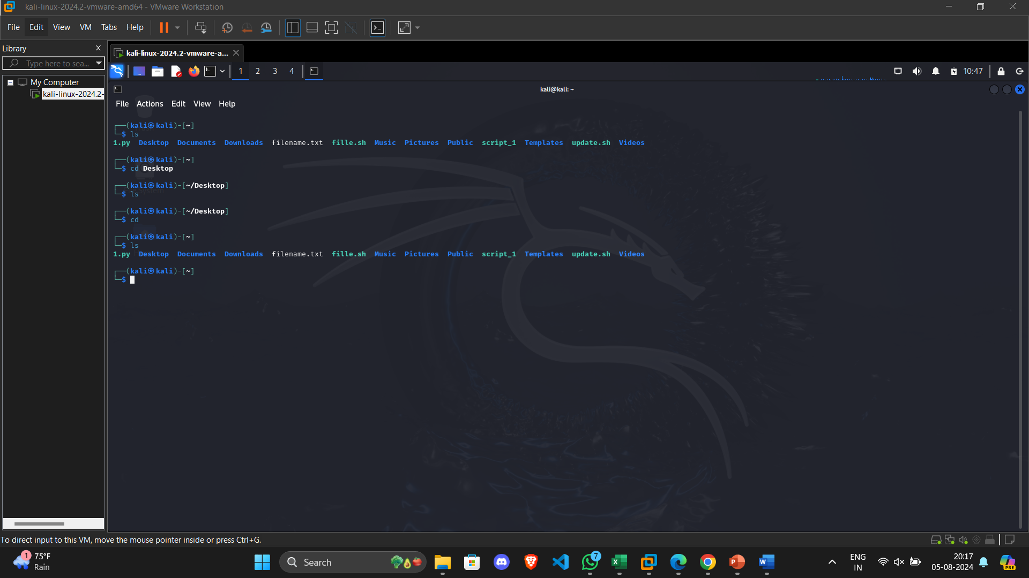
To navigate home directory

Slide 21
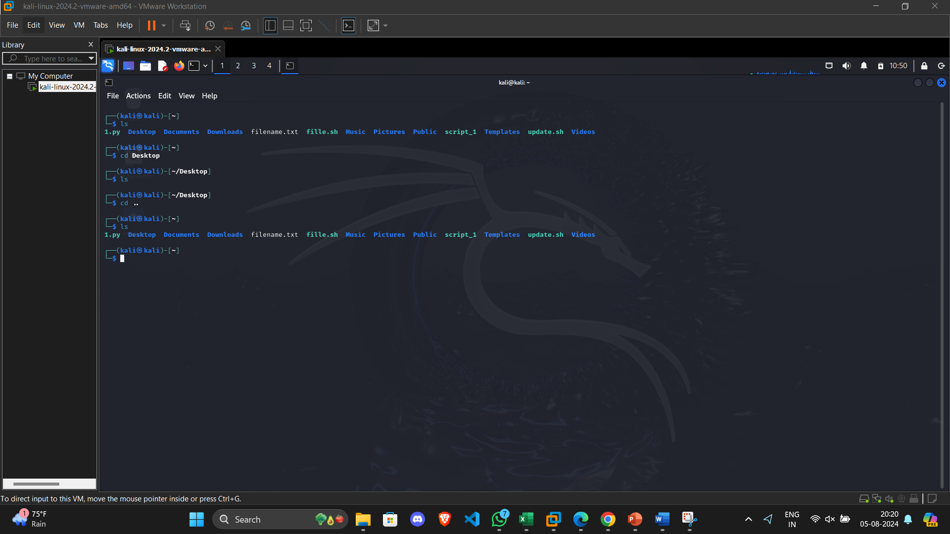
To navigate to the parent directory

Slide 22
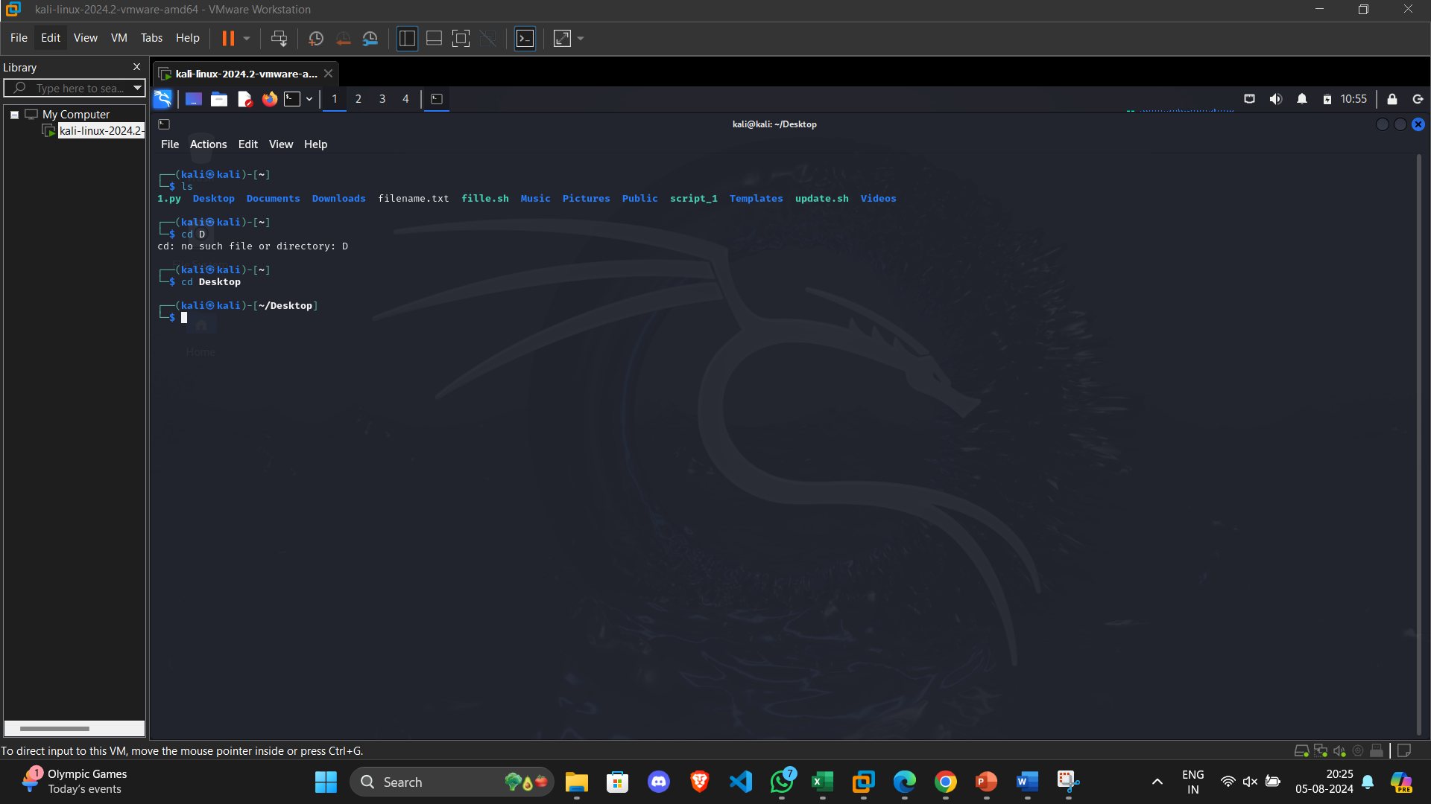
To navigate to the child directory

Slide 23
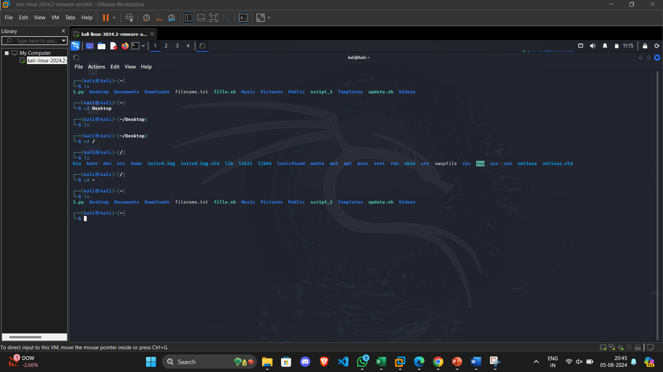
To go to the root directory

Slide 24
Task | Syntax | Command
How to identify the file system | lsblk -f | lsblk -f

Slide 25
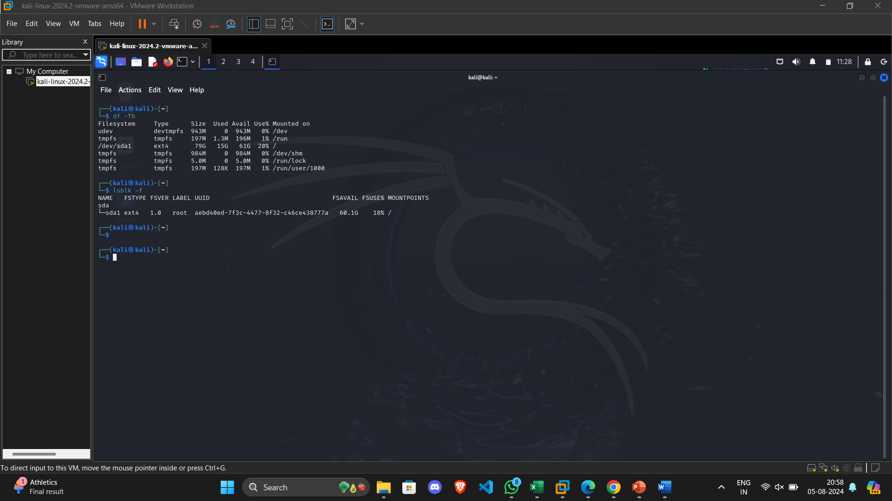
How to identify the file system

Slide 26
cd ..
cd ..
Create Folder “CYS”
mkdir CYS
b. Navigate to CYS
cd CYS
c. Create folder LS1 and LS2 under CYS
mkdir LS1 LS2
d. Go back to CYS
cd ..

Slide 27
Working with Files
Add commands which you learnt during lab session in the file commands.txt
echo “mkdir, cd, rm , ls , man , touch , cat, mv, type”> commands.txt
Change the timestamp of the file to yesterday
touch -d "yesterday" commands.txt
Copy the contents from the file commands.txt to commands_demo.txt
cp commands.txt commands_demo.txt
Rename the file commands_demo.txt to duplicate
mv commands_demo.txt duplicate
Rename all .html to .hldd
for file in *.html; do mv "$file" "${file%.html}.hldd"; done
Delete the file duplicate
rm duplicate
Copy the contents commands.txt to unit4 and unit5 (using relative path)
cp commands.txt unit4
cp commands.txt unit5
Delete the contents from unit5 (using absolute path)
rm /path/to/CYS/unit5/commands.txt

Slide 28
Navigate to root
cd /
List all the files under root
ls -a
Explore all the folders (Do not delete any folder)
ls -l
Navigate to /etc/passwd
cd /etc
Open the file passwd
cat passwd
Explore the file passwd
cat passwd
Navigate to /etc/group and explore
cd /etc
cat group

Slide 29
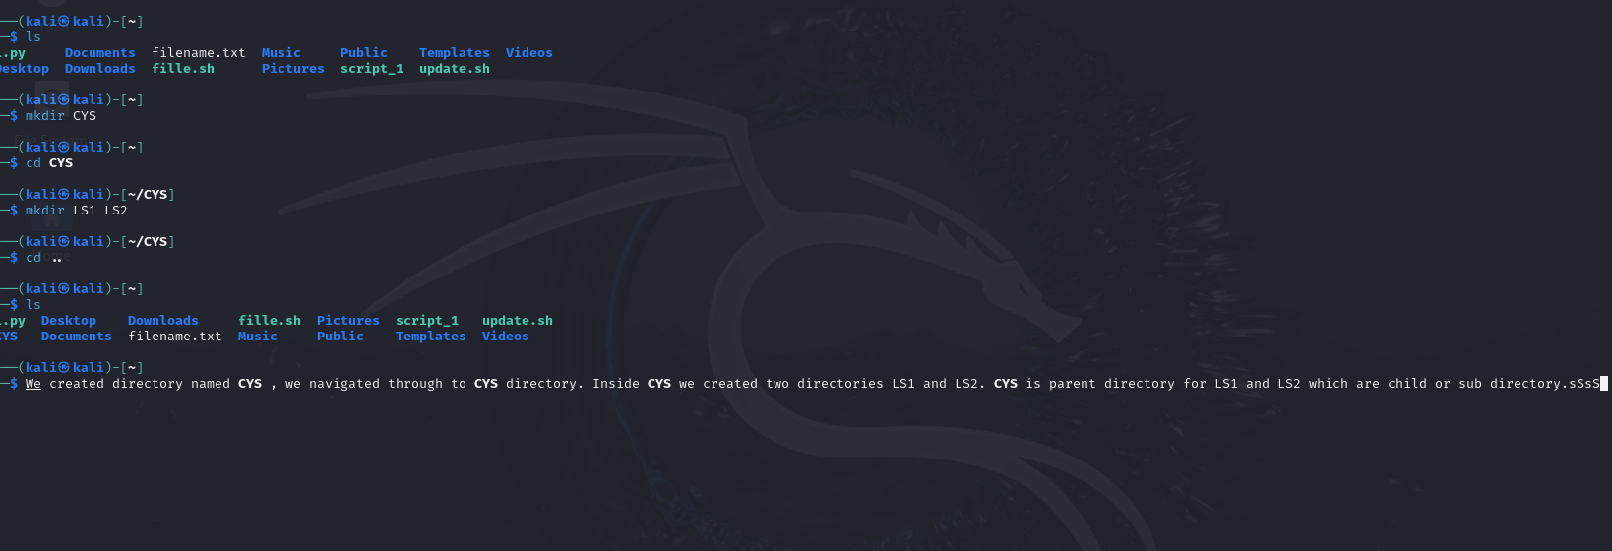

Slide 30
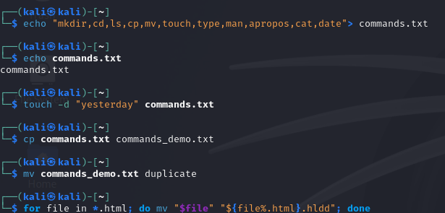

Slide 31
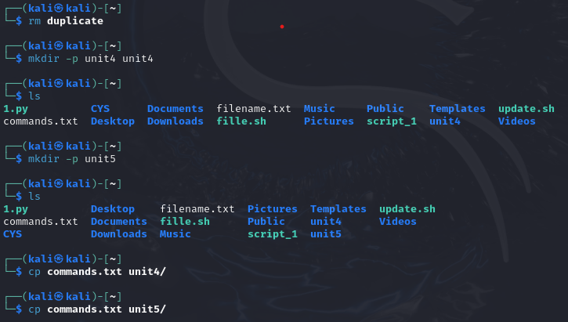

Slide 32
CLI(Command Line Interface)
GUI (Graphical User Interface)
Here commands and text are the medium to interact with the system.
Bit complicated for naïve users as there is no colours or interface . Smallest of smallest things need to be done using commands.
More powerful as you have more control over system functions.
Faster feel for experienced user as there are many repetitive tasks.
Since there is no Graphics involved hence it consumes low memory.
Faster since no involvement of graphics.
No use of any pointing device.
Few CLI give the access for multitasking but it becomes difficult or complicated to see several commands on one screen .
Can take help of scripts to carry series of programs.
Spelling mistakes in entering the commands are not accepted , as it wont run the command if there is even a small mistake .
We get buttons , links , menus , windows and icons to interact with the system which carry out our tasks.
Easy to understand , even a child can understand and access various files and documents.
Generally requires more tools and resources for operations.
Easy to navigate and track location of files and folders as it is pictorially present in your screen.
Here lot of graphics and graphical work is involved hence consumes more memory.
Slower since there is lots of graphics used which need time to load .
There is use of pointing devices like cursor etc.
Multitasking becomes easily understandable.
Scripts are available but not necessarily needed to perform sequence of commands.
Minor mistakes can be neglected.

Slide 33
man
info
man (manual) as name suggest is a linux manual for easy access of all types of data regarding any command present in linux .
We need to type ‘man’ followed with command you want help with.
Eg. man ls
Easy to access and read.
Gives data in format of NAME, SYNOPSIS , DESCRIPTION , OPTIONS ,etc.
Sometimes the data shown can be not enough for the user .
Few times it is harder to navigate for beginners.
Faster and easier access for quick reference.
It displays more detailed documentation for commands and programs , the details shows are better than man command.
Syntax is something like info followed by the command name.
Eg- info ls
The main advantage is that it provided more detailed information for the user.
Additional links are given to related topics which makes easier to explore futher.
Sometimes more information can make the things more confusing.
All commands are not shown by info command .
More detailed and in –depth information for better understanding .

Slide 34
Which vs whereis
whereis and which are both commands used to locate executables in a Linux system, but they have different scopes and functionalities.
The purpose of which is to locate binary , source code and manual page for a command.
Searches predefined system directories (including $PATH and $MANPATH). Syntax- whereis ls
Whereas the purpose of whereis is to provide more comprehensive information about a command , it is more specific to finding executables location.
We use whereis when we need to know location of cource code or manual pages in addition to executable.
And which command is used to find the executable path and when you are sure that its in your $PATH.

Slide 35
Terminal vs Shell
Terminal – It is a program which provides text-based interface for entering , displaying commands and to get their output .
It is a window where the user interact with shell . Shell then forwards the information or command to the kernal.
It takes input from user through keyboard and output is displayed on screen. One terminal can support multiple shells simultaneously by opening multiple tabs.
Examples – xterm , Terminal in macOS , command prompt .
Shell works on command line interpreter , it provides user interface for operating system . User commands are interpreted and executed line by line .
It reads the commands entered by the user, interprets them, and then invokes the appropriate system calls or utility programs.
Shells support scripting, which allows users to write scripts to automate tasks. These scripts can be as simple as a list of commands or complex programs with variables, loops, and conditionals.
Shells allow users to set environment variables that can affect the behavior of processes.
Types of shell are – Bourne shell , Bash , Zsh ,Fish , PowerShell etc.

